Slide 1
Building an AI Pipeline for Image Segmentation and Object Analysis Objective : To develop a comprehensive pipeline for image processing that includes segmentation, object extraction, identification, and data extraction, leading to the generation of summarized outputs. This project aims to automate the process of analyzing images by breaking them down into individual objects, identifying these objects, and extracting relevant data for further use.

Slide 2
Building an AI Pipeline for Image Segmentation and Object Analysis
Objective : To develop a comprehensive pipeline for image processing that includes segmentation, object extraction, identification, and data extraction, leading to the generation of summarized outputs. This project aims to automate the process of analyzing images by breaking them down into individual objects, identifying these objects, and extracting relevant data for further use.

Slide 3
Tools Used :
Programming Language: Python
Libraries and Frameworks:
TensorFlow/Keras: For building and training deep learning models, particularly for image segmentation and object detection.
OpenCV: For image processing tasks such as segmentation, object extraction, and visualization.
Pandas: For organizing and mapping the extracted data into structured formats like DataFrames.
NumPy: For numerical operations and data manipulation.
Pytesseract: For Optical Character Recognition (OCR) to extract text from images.
Development Environment:
Jupyter Notebook: For interactive development, testing, and visualization of results.
Other Tools:
Matplotlib/Seaborn: For plotting and visualizing data and segmentation results.

Slide 4
Steps :
Step 1: Image Segmentation
Objective: Segment the image into distinct regions to isolate objects within the image.
Approach:
Use of techniques like thresholding, edge detection, or deep learning models (e.g., U-Net) to segment images.
Convert the original image into a binary mask or multiple segments.
Step 2: Object Extraction and Storage
Objective: Extract individual objects from the segmented image and store them for further processing.
Approach:
Identify the contours or bounding boxes of objects.
Extract these objects and save them as separate image files or objects in memory.

Slide 5
Steps
Step 3: Object Identification
Objective: Identify and label the extracted objects.
Approach:
Use a pre-trained object detection model (like YOLO, Faster R-CNN) to classify objects.
Assign labels such as "car," "train," or "No object detected" based on the confidence scores.
Step 4: Text/Data Extraction from Objects
Objective: Extract any text or specific data from the identified objects.
Approach:
Use Optical Character Recognition (OCR) techniques for text extraction.
Extract other relevant data attributes if applicable, such as color, size, or shape.

Slide 6
Steps
Step 5: Summarize Object Attributes
Objective: Compile a detailed summary of each object's attributes.
Process:
Combine the object's label, confidence score, and any extracted data into a concise summary.
Example: "Object 'car' identified with 89% confidence, no text detected.“
Step 6: Data Mapping
Objective: Structure the summarized object data for easy access and further analysis.
Process:
Organize the summaries and attributes into a structured data format like a DataFrame or JSON.
Ensure the data is prepared for any additional steps, such as reporting or analysis.

Slide 7
Steps
Step 7: Output Generation
Objective: Generate the final output that encapsulates all the processed data and findings.
Process:
Produce visual outputs, like annotated images with labeled bounding boxes.
Generate and save reports or data files (e.g., CSV, JSON) containing the summarized information.

Slide 8
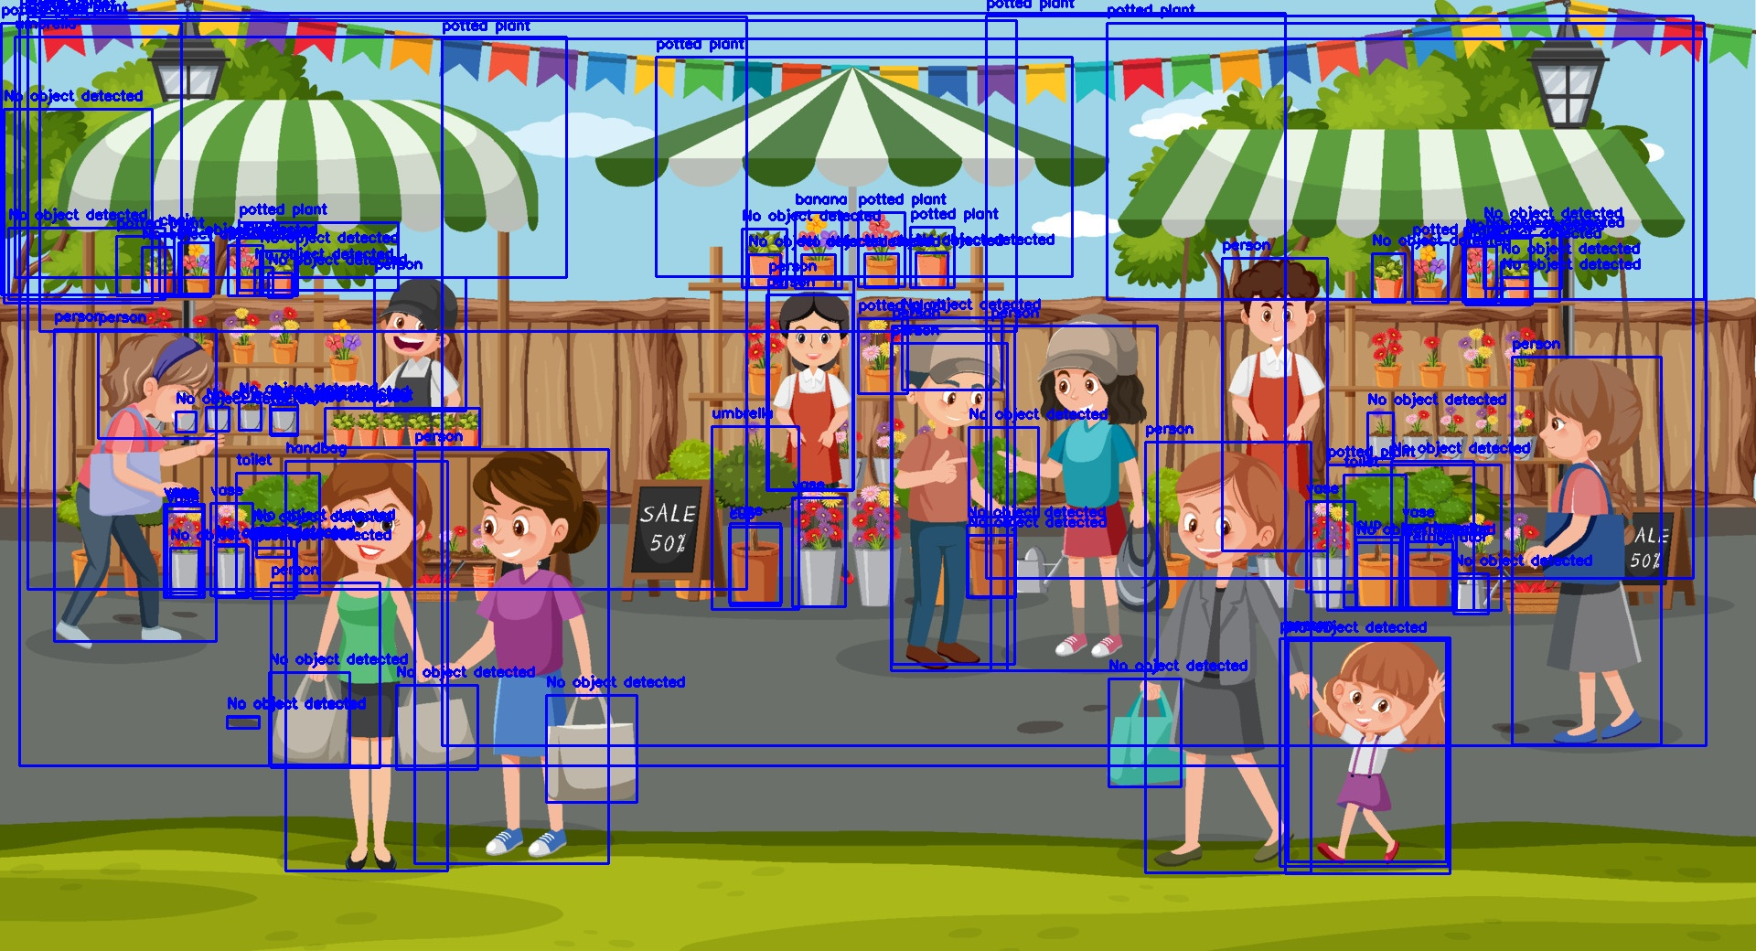
Output Annotated Image

